Slide 1
Exploratory Data Analysis Dr Mariana Rocha School of Computer Science
CMPU 2007 Databases 1, Lecture 9

Slide 2
Learning Objectives
Understand the concept of Exploratory Data Analysis (EDA)
Understand the application of SQL to deliver an EDA report

Slide 3
Exploratory Data Analysis (EDA)
Exploratory Data Analysis is applied to identify patterns and relationships between different variables on the data, helping us to generate hypotheses for further analysis.
We will use EDA as a way to review some important SQL concepts for data retrieval.

Slide 4
EDA Steps
Step 1: Understand the structure (tables, relationships, metadata).
Step 2: Preview the data (sample rows, counts).
Step 3: Data quality checks (missing values, duplicates, inconsistent codes).
Step 4: Descriptive statistics (distributions, averages, counts).
Step 5: Relationships (joins between tables, correlations, group comparisons).
Step 6: Identify anomalies/outliers.

Slide 5
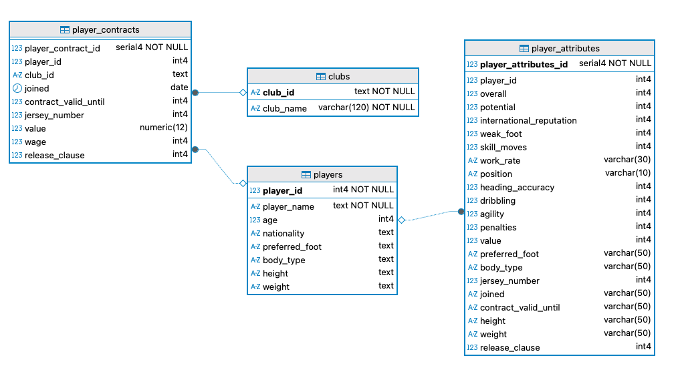
EDA - Football

Slide 6
Step 1: Understand the structure (tables, relationships, metadata)
To perform that step, we can use the information.schema, a set of views that contain information about the objects defined in the current database.
It acts as a repository for metadata, which is data about the data and its structure within the database.

Slide 7
Step 1.1: Gather tables names
The first step is to identify what tables are stored in our schema.
SELECT table_name
FROM information_schema.tables
WHERE table_schema = 'football'
AND table_type = 'BASE TABLE' --rather than a view
ORDER BY table_name;

Slide 8
Step 1.2: Identify columns, data types and nullability
We will select the attributes table_name, column_name, data_type and is_nullable.
This should be repeated for each table in the schema.
We also order by ordinal position, which is the order in which the columns were created.
SELECT table_name, column_name, data_type, is_nullable
FROM information_schema.columns
WHERE table_schema = 'football' AND table_name = 'players'
ORDER BY ordinal_position;

Slide 9
Step 1.3: Identify the tables’ constraints
Allow us to know what constraints were established and how PostgreSQL named them.
SELECT table_name, constraint_name, constraint_type FROM information_schema.table_constraints WHERE table_schema = 'football';

Slide 10
Step 2: Preview the data (sample rows, counts)
Now, we will retrieve data straight from the tables using aggregate formulas and filtering commands (order by, limit, group by etc.).

Slide 11
Step 2.1: Cross-table coverage
The command below uses subqueries to count the number of rows in each table for comparison.
SELECT
(SELECT COUNT(player_id) FROM players) "Total number of players",
(SELECT COUNT(club_id) FROM clubs) "Number of clubs",
(SELECT COUNT(DISTINCT player_id) FROM player_attributes) "Number of players with attributes",
(SELECT COUNT(DISTINCT player_id) FROM player_contracts) "Number of players with contracts";

Slide 12
Step 2.2: Preview data – first 10 rows
We can also take a quick look at the first 10 rows of each table using the command LIMIT 10.
-- Show the first 10 rows of a table
SELECT * FROM players LIMIT 10;

Slide 13
Step 2.3: Preview specific conditions
Other data preview can be more specific.
-- Show distinct values of a column
SELECT DISTINCT nationality
FROM players;
-- Random sample of 5 rows
SELECT * FROM players ORDER BY RANDOM() LIMIT 5;
-- Preview top players by rating
SELECT player_id, overall
FROM player_attributes
ORDER BY overall DESC
LIMIT 10;

Slide 14
Step 2.4: Preview maximum and minimum values
Part of the preview can also be done considering the maximum and minimum values. This gives us an idea of the range of values available in the database.
SELECT MIN(joined) "First contract date",
MAX(joined) "Last contract date",
MIN(contract_valid_until) "Minimum expiry year",
MAX(contract_valid_until) "Maximum expiry year"
FROM player_contracts;

Slide 15
Step 2.5: How big are the clubs?
Another interesting measure is to identify how many contracts each club has.
As we are grouping the contracts according to the club name, we need to use the GROUP BY command.
SELECT club_name, COUNT(*) "Number of contracts"
FROM player_contracts
JOIN clubs USING (club_id)
GROUP BY club_name
ORDER BY contracts DESC
LIMIT 10;

Slide 16
Step 3: Data quality checks
We will retrieve data straight from the tables considering specific scenarios such as null data, duplicates and orphan values.

Slide 17
Step 3.1: Null profiling
We start by checking how many rows are NULL for a certain attribute. This can be repeated for different tables and different attributes.
SELECT
COUNT(*) "Total number of rows",
COUNT(*) FILTER (WHERE heading_accuracy IS NULL) "Number of rows where heading accuracy is NULL",
COUNT(*) FILTER (WHERE weight IS NULL) "Number of rows where weight is NULL",
COUNT(*) FILTER (WHERE overall IS NULL) "Number of rows where overall is NULL"
FROM player_attributes;

Slide 18
Step 3.2: Duplicates
We now want to evaluate if there are duplicates in our data. That’s important as it might require data cleaning before progressing with the analysis.
For example, we do not expect the same player to have multiple rows in the player_attributes table, so we can try to identify that.
SELECT player_id, COUNT(*) "Rows per player"
FROM player_attributes
GROUP BY player_id
HAVING COUNT(*) > 1
ORDER BY rows_per_player DESC;

Slide 19
Step 3.3: Orphan references
In a relational database, an orphan value is a child record that refers to a parent that doesn’t exist. This can happen when foreign keys are not enforced or when values are deleted in the parent table.
For example, we can check if there are any contracts pointing to clubs that no longer exist.
SELECT pc.player_contract_id, pc.player_id, pc.club_id, pc.joined, pc.contract_valid_until
FROM player_contracts pc
LEFT JOIN clubs c
USING (club_id)
WHERE c.club_id IS NULL;

Slide 20
Step 4: Descriptive statistics
In EDA, we use descriptive statistics to identify measures of central tendency (central values like mean) and measures of variability (such as minimum and maximum values).

Slide 21
Step 4.1: Summaries
The summary can include:
total number of values for an attribute
minimum value
average (sum of all values divided by the number of values)

Slide 22
Step 4.1: Summaries
SELECT
COUNT(*) "Total players",
COUNT(age) "Total players with age value",
MIN(age) "Minimum value for age",
MAX(age) "Maximum value for age",
AVG(age) "Average value for age”
FROM players;

Slide 23
Step 4.3: Measure central tendency and spread for financial attributes
We can combine central tendency and spread values to identify patterns.
For example, we are looking into minimum and maximum wages, the average wage, and the median wage.
Compare mean vs median: if mean > median, our data is skewed by a few top earners.
When we look at the average result, we might think football players make a lot of money – however, this is skewed by the top earners.

Slide 24
Step 5: Relationahips
We now start to attempt to understand how variables interact. We might also use JOINs to check the interaction between different tables.

Slide 25
Step 5.1: Overview of main attributes of all tables
This creates a single analytical view of each player: who they are, how good they are, where they play, and how much they earn.
SELECT
player_name,
overall,
potential,
wage,
club_name
FROM players
JOIN player_attributes USING (player_id)
JOIN player_contracts USING (player_id)
JOIN clubs USING (club_id);

Slide 26
Step 5.2: Club spend vs average rating
We can run two joins to evaluate if the money spent by a club is in line with the overall rating.
SELECT club_name "Club",
COUNT(*) "Number of players",
SUM(wage) "Spent on wage",
AVG(overall) "Overall rate"
FROM player_contracts
JOIN clubs USING (club_id)
LEFT JOIN player_attributes USING (player_id)
GROUP BY club_name
ORDER BY 3 DESC NULLS LAST;

Slide 27
Step 5.3: Players registered but without a contract
We can check if a player is registered on the database but has no contract (missing links between tables player_attributes and player_contracts).
SELECT p.player_id, p.player_name, pc.player_contract_id
FROM players p
JOIN player_attributes pa USING (player_id)
LEFT JOIN player_contracts pc USING (player_id)
WHERE pc.player_id IS NULL
ORDER BY p.player_name;

Slide 28
Step 6: Anomalies and outliers
Finally, we will check if there is any weird pattern or data out of place.

Slide 29
Step 6.1: Joined date after expiring date
We want to check if the joining year (joined) is greater than the expiring year of the contract (contract_valid_until).
Notice that joined is a date data type and contract_valid_until is an integer. We need to extract the year from the attribute joined.
SELECT player_id, joined, contract_valid_until
FROM player_contracts
WHERE contract_valid_until IS NOT NULL
AND joined IS NOT NULL
--joined is a date data type, we need to extract the year
AND EXTRACT(YEAR FROM joined) > contract_valid_until;

Slide 30
Step 6.2: Unrealistic ages
In the case of our database, we do not expect to find players younger than 14 years old and older than 50 years old.
We can try to catch those outliers.
SELECT player_id, player_name, age
FROM players
WHERE age < 14 OR age > 50;

Slide 31
Step 6.3: Wage outliers
We can try to identify which players make more money than average and how much more they make.
SELECT
p.player_name,
c.club_name,
pc.wage,
pa.overall,
--we use a subquery because avg() expects a group by at the end
ROUND(pc.wage / (SELECT AVG(wage) FROM player_contracts WHERE wage IS NOT NULL), 2) "Times above the average"
FROM player_contracts pc
JOIN players p USING (player_id)
LEFT JOIN player_attributes pa USING (player_id)
LEFT JOIN clubs c USING (club_id)
WHERE pc.wage IS NOT NULL
ORDER BY pc.wage DESC LIMIT 10;

